Slide 1
Compiler Construction
Mukesh Kumar Tripathi
Assistant Professor
Department of Information Technology
Vasavi College of Engineering

Slide 2
Top-Down Parsing
Top-down parsing can be viewed as the problem of constructing a parse tree for the input string, starting form the root and creating the nodes of the parse tree in preorder.
A Top-down parser tries to create a parse tree from the root towards the leafs scanning input from left to right
It can be also viewed as finding a leftmost derivation for an input string
Given the grammar :
E → TE’
E’ → +TE’ | ε
T → FT’
T’ → *FT’ | ε
F → (E) | id
The input: id + id * id

Slide 3
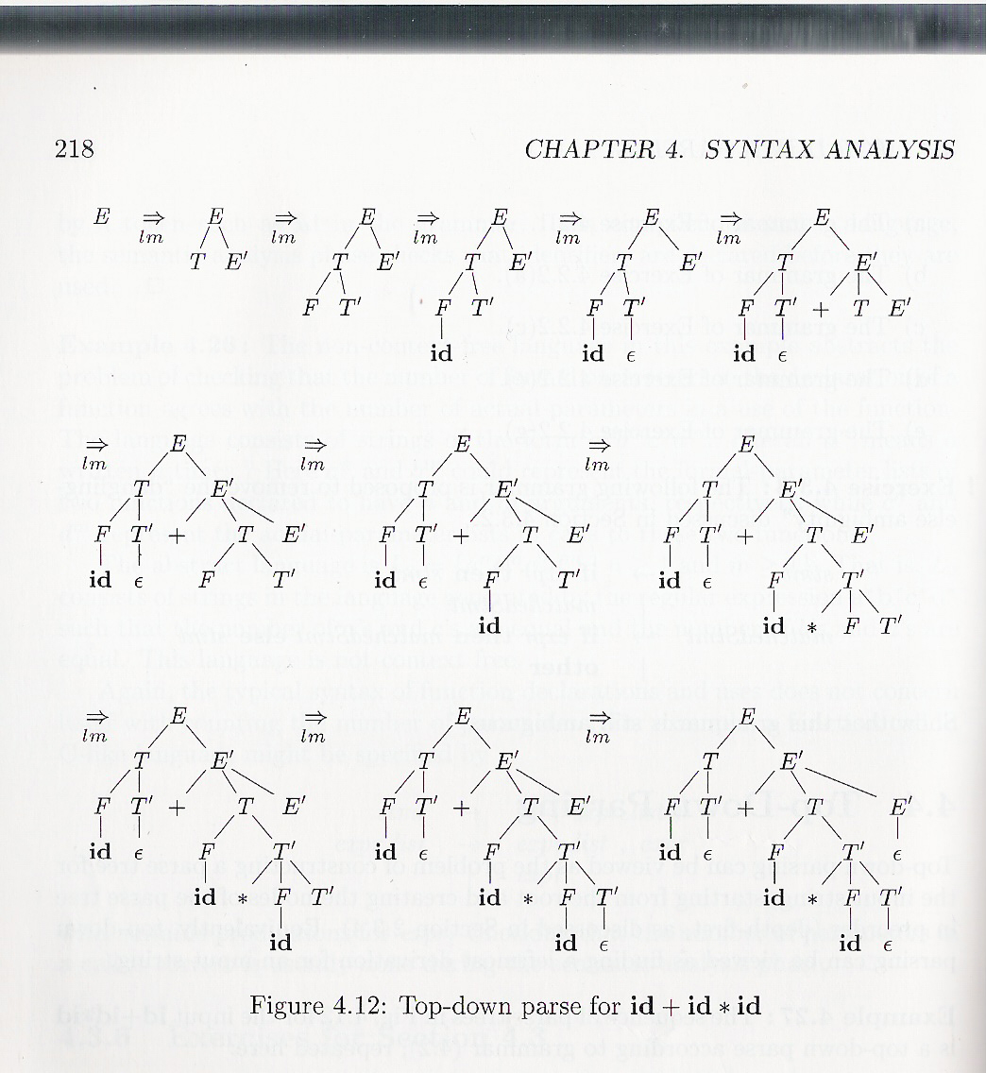
Top-Down Parsing (contd.)
Given the grammar :
E → TE’
E’ → +TE’ | ε
T → FT’
T’ → *FT’ | ε
F → (E) | id
The input: id + id * id

Slide 4
Recursive Descent Parsing
Consists of a set of procedures, one for each nonterminal
Execution begins with the procedure for the start symbol
A typical procedure for a non-terminal
void A() {
choose an A-production, A→X₁X₂…X_{k}
for (i=1 to k) {
if (X_{i} is a nonterminal)
call procedure X_{i}();
else if (X_{i} equals the current input symbol a)
advance the input to the next symbol;
else /* an error has occurred */
}
}
Notes:
Backtracking is needed. It is a general parsing technique, but not widely used.
Not efficient

Slide 5
Recursive Descent Parsing (contd.)
Each non-terminal corresponds to a procedure.
Ex: A → aBb (This is only the production rule for A)
proc A {
- match the current token with a, and move to the next token;
- call ‘B’;
- match the current token with b, and move to the next token;
}

Slide 6
Recursive Descent Parsing (contd.)
A → aBb | bAB
proc A {
case of the current token {
‘a’: - match the current token with a, and move to the next token;
- call ‘B’;
- match the current token with b, and move to the next token;
‘b’: - match the current token with b, and move to the next token;
- call ‘A’;
- call ‘B’;
}
}

Slide 7
Recursive Descent Parsing (contd.)
When to apply ε-productions.
A → aA | bB | ε
If all other productions fail, we should apply an ε-production. For example, if the current token is not a or b, we may apply the ε-production.

Slide 8
Recursive Descent Parsing (contd.)

Slide 9
Recursive Descent Parsing (contd.)

Slide 10
Recursive Descent Parsing :: Backtracking
General recursive descent parsing may require backtracking (If a choice of a production rule does not work, we backtrack to try other alternatives.)
The previous code needs to be modified to allow backtracking
In general form it canot choose an A-production easily.
So we need to try each of several alternatives in some order.
If one failed the input pointer needs to be reset and another alternative should be tried
Recursive descent parsers cant be used for left-recursive grammars
void A() {
choose an A-production, A→X₁X₂…X_{k}
for (i=1 to k) {
if (X_{i} is a nonterminal)
call procedure X_{i}();
else if (X_{i} equals the current input symbol a)
advance the input to the next symbol;
else /* an error has occurred */
}
}

Slide 11
Backtracking (contd.)
Consider the grammar:
S → c A d
A → ab | a
The input string is “cad”

Slide 12
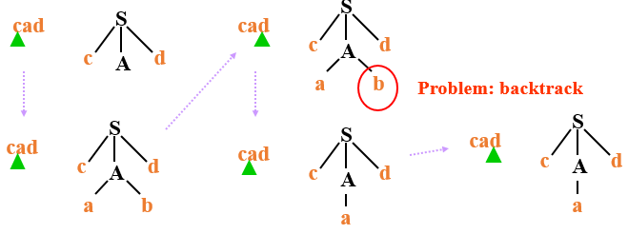
Backtracking (contd.)
Consider the grammar:
S → c A d
A → ab | a
The input string is “cad”

